Slide 2
Oral Statements
Oral statements or discussion during the pre-bid meeting today will not be binding, nor will it change or affect the terms or conditions within the Plans and Specifications of this Project. Changes, if any, will be addressed in writing only via an Addendum.

Slide 3
Agenda
General Information
Small, Minority, Women and Veteran-Owned Business (SMWVB Requirements)
Contract Requirements
Bid Packet Preparation
Addendums
Vendor Registration
Bid Opening Dates/Time
Technical Information

Slide 4
General Information
Non-mandatory pre-bid meeting and site visit
254 Seale Road, San Antonio, Texas 78219
Attendees should sign-in
Sign-in sheet(s) will be posted on SAWS website
Construction services being procured through IFB
Environmental Reports made available on SAWS website

Slide 5
General Information
Calendar days:
90 days
Estimated Cost: $239,352.00

Slide 6
Aspirational SMWB Goal
Industry | Aspirational SMWB Goal
Construction | 20%
Aspirational SMWB goal = 20% of total bid price.
Notes:
SMWB

Slide 7
Accepted SMWVB Certification Agency
South Central Texas Regional Certification Agency
  MBE, WBE, SBE (Includes “HUB” Program)
Minimum Qualifications for SMWVB recognition:
SBE-Certified (even MBEs and WBEs)
Local office or local equipment yard

Slide 8
Good Faith Effort Plan (GFEP) FAQs
Q: Is the 20% SMWVB goal mandatory?
A: No, but we ask prime consultants to do their best with good faith outreach efforts. If the goal is not met, proof of outreach efforts is required with the submittal.
Q: What if I am having trouble finding SMWVB subconsultants?
A: Please email the SMWVB Program Manager with the scopes of work you are seeking. You will receive lists of local SMWVB-certified firms to contact.
Q: What if my business is SMWVB-certified? Do I need to find SMWVB subs?
A: If your firm is SMWVB-certified, you will most likely meet the goal. However, the GFEP is a required document, and a good faith outreach effort is still necessary.
Q: What if I have questions about the GFEP?
A: Please contact the SMWVB Program Manager at 210-233-3420, or at Marisol.Robles@saws.org. GFEP questions can be asked at any time before the submittal is due.

Slide 9
Post Award: Subcontractor Payment & Utilization Reporting (S.P.U.R.) System
1. Subcontractor & Supplier Payment Tracking, Changes, & LCP Tracker
3. Must be Current and Accurate before Retainage is released https://saws.smwbe.com/

Slide 10
Contract Requirements
Prevailing Wage Rate and Labor Standards – Section 2.10 of the General Conditions
Certified payroll to be submitted on weekly basis
Wage decisions are included within the specifications
Contractors to utilize LCP Tracker
Payroll records are subject to review
All apprenticeship programs will need to be approved by Department of Labor prior to starting
Contractors are responsible for sub-contractor payroll
Late payrolls delay contractor payments from SAWS

Slide 11
Contract Requirements
Insurance requirements are found in Section 5.7 of the GCs
  Builder’s Risk is replaced by Installation Floater (see Supplemental Conditions)
  Maintain insurance coverage during the construction of this Project
Compliant prior to executing the contract
Will ask for insurance prior to Board award to expedite execution of the contract

Slide 12
Bid Packet Preparation
Utilize the Bid Packet Checklist within the specifications
Statement of Bidder’s Experience to be completed and included by all Bidders
  Statement of Bidder’s Experience Form includes: Project manager and superintendent resumes detailing work experience and references to include 3 similar projects, general project experience, and specific project experience
Apparent Low Bidder to submit Company Information Packet, Statement regarding ability to complete the project, W-9 and Record of Performance/Similar Projects.

Slide 13
Bid Packet Preparation
Double check all mathematical calculations
Be aware of the allowances provided
Be aware of the Site Mobilization Maximum (10% of total line items 1-6)
References and contact information must be verified prior to submitting, Addendums are now acknowledged on the Bid Proposals

Slide 14
Addendum(s)
Revisions, Clarifications, Questions and Answers (Q&A’s)
Questions deadline is February 25, 2020 by 2 P.M.
Q&A’s will be posted on SAWS website on March 2, 2020 by 4 P.M.
Check our website regularly for the addendum posting.
It is possible to have multiple addenda during the time frame in addition to the scheduled final addendum.

Slide 15
Vendor Registration & Notification (VRN)
Reasons to Register in the VRN
Receive bid notices directly in your email “Inbox”.
Download bid documents.
Subscribe to specific bids.
Receive addendum notifications.
http://www.saws.org/business_center/vendor/register.cfm

Slide 16
Bid Opening Dates/Times
March 9, 2020 at 1:30 PM
Bids will then be publicly opened and read aloud by Contract Administration in CR-C137, Customer Center Building, 2800 U.S. Hwy 281 North, San Antonio, Texas.
Bids may not be late
  Late bids will not be accepted and will be returned unopened
Make arrangements if mailing and send directly to Contract Administration
If delivering in person, bid packets will be turned in at Counter Services

Slide 17
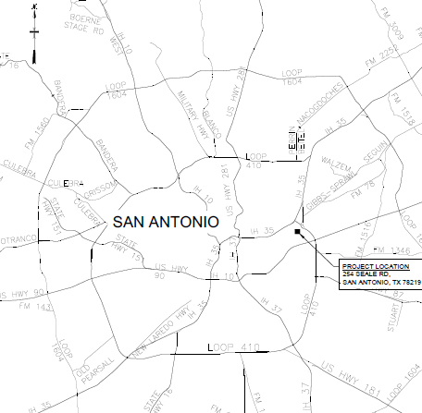
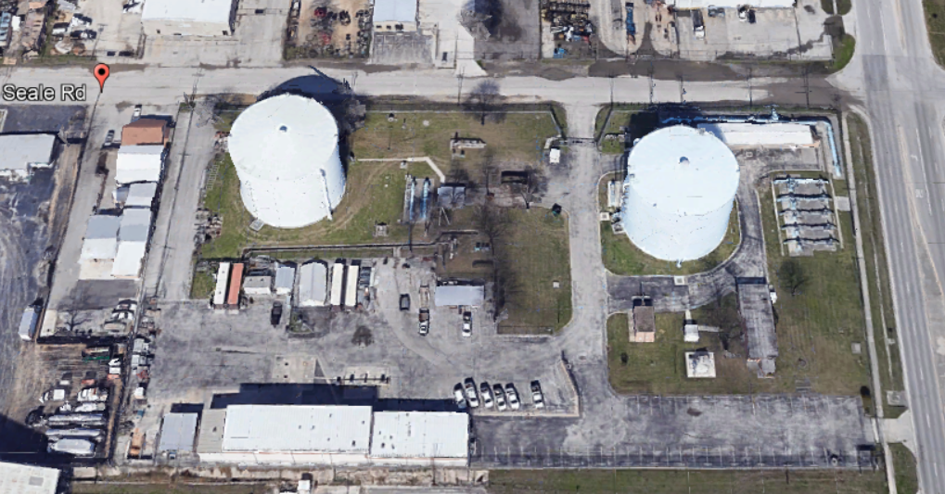
Project location- 254 Seale Road, San Antonio, TX
Construction entrance
Fuel dispensing facilities

Slide 18
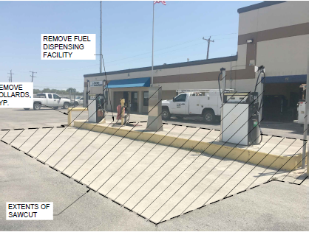
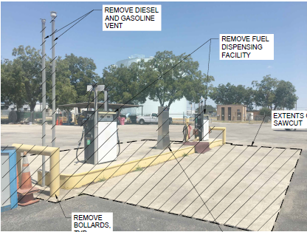
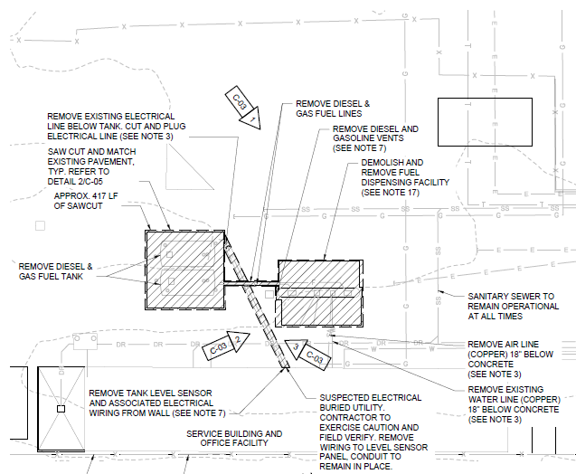
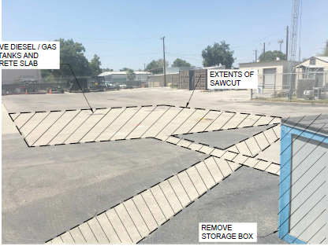
Scope of Work
Install E&S controls
Saw cut pavement
Remove diesel and gas fuel tanks
Remove diesel and gas fuel lines
Remove diesel and gasoline vents
Remove fuel dispensing facility
Remove tank level sensor and associated electrical wiring
Remove existing air line and water line
Backfill and pave with asphalt

Slide 19
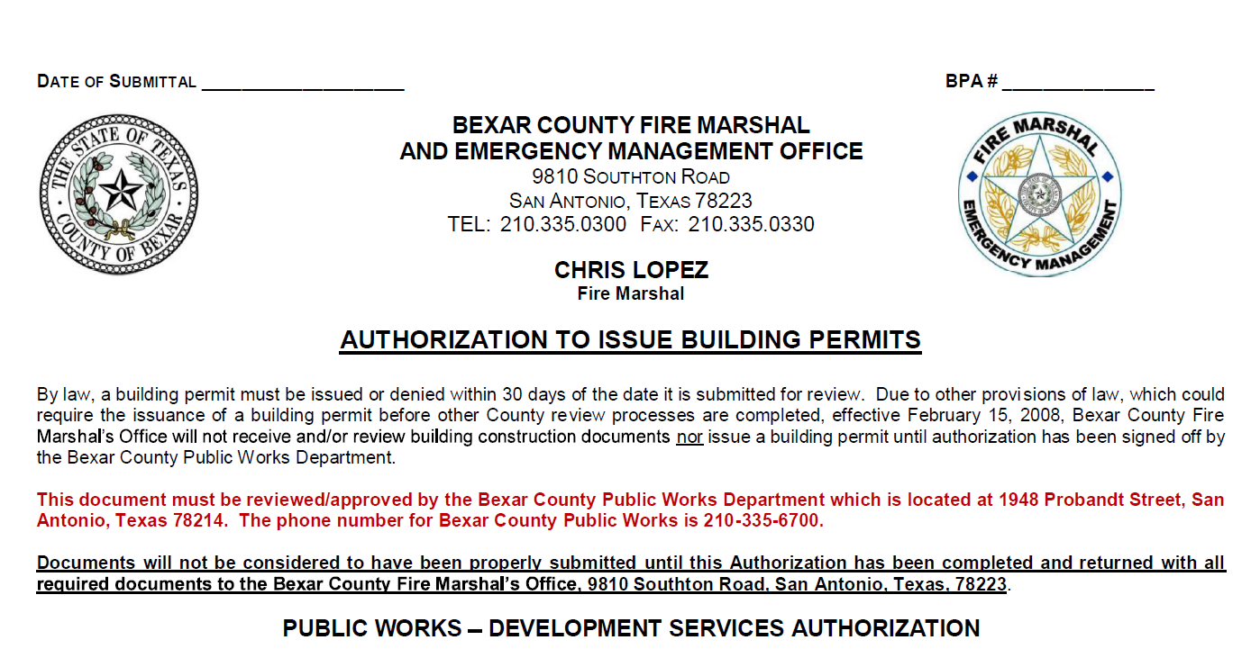
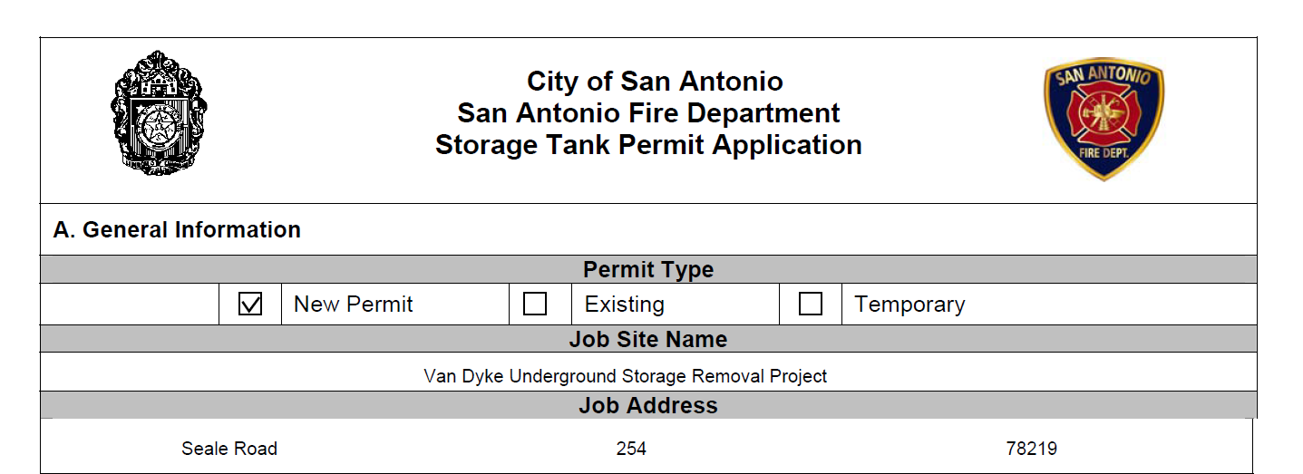
Permitting/Regulatory Requirements
Bexar County Building Permit: Bexar County Fire Marshal and Emergency Management Office
City of San Antonio Fire Department Storage Tank Permit Application
TCEQ Pre-Construction Notification of UST Removal
Storage tanks removal in accordance with 30 TAC Chapter 334
TCEQ, EAA, and/or City of San Antonio Fire Marshal and Bexar County inspector to be on site during storage tank removal

Slide 20
Project Requirements
Contractor to maintain access for SAWS personnel at all times, including TCEQ monitoring station.
Contractor to keep sanitary sewer operational at all times.
Contractor to ensure clearance for the bays in the service building.
Contractor shall keep the fuel control terminal intact during removal and return to SAWS.
Security guard required at all times while work is occurring.
Lead and asbestos survey results.
Allowances.

Slide 21
Contact Information
Contact Name | Title | Telephone Number | Email address
Roxanne Lockhart | Contract Administrator | 210-233-3095 | Roxanne.Lockhart@saws.org
Marisol Robles | SMWVB Program Manager | 210-233-3420 | Marisol.Robles@saws.org
REMINDER
Please be advised that Bidders are prohibited from communicating with any other SAWS staff, the Consultant, the Developer, or City of San Antonio officials regarding this IFB up until the contract is awarded as outlined in the Instructions to Bidders

Slide 22

QUESTIONS
Thank you!

